Slide 1


DATA INSIGHTS FOR RADIANT GIRLS LEADERSHIP FOUNDATION
CAPSTONE DATA ANALYTICS PROJECT
August 25, 2025
Presented By,
Mayuri Miarshi, Marmik Vyas, Vidhi Bhalani, Kishan Kakadiya

Slide 2

Project Objectives
Improve SEO for higher visibility.
Refresh content to reflect programs & goals.
Add chatbot for real-time engagement.
Integrate videos to showcase impact.
Set up analytics for performance tracking.

Slide 3



Data Sources
Website traffic & click-through data.
Data Collection
Google impressions & device usage.
Data Analysis
Gender distribution of audience.
Actionable Insights

Slide 4

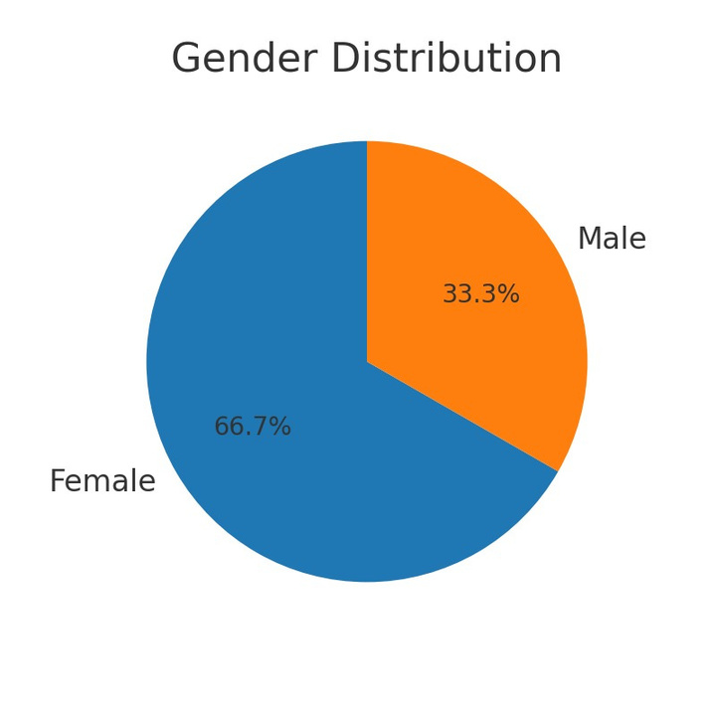
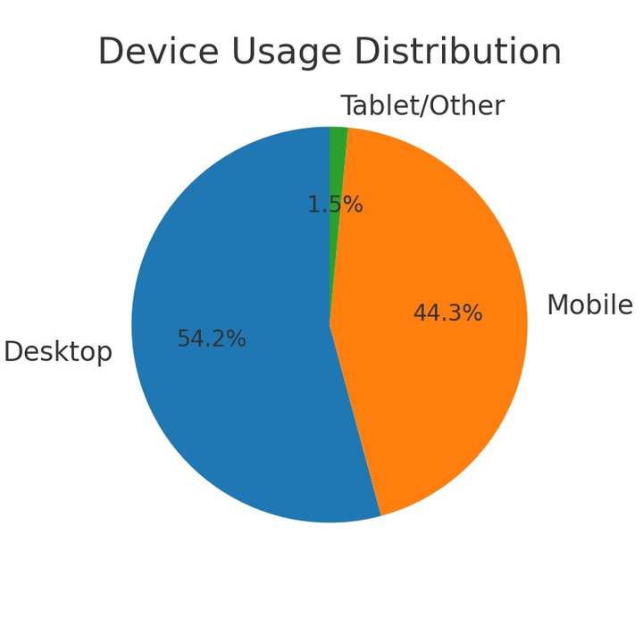
EDA: Audience Overview
Female audience: ~67%
Male audience: ~33%
Device usage: 54% desktop, 44% mobile.

Slide 5

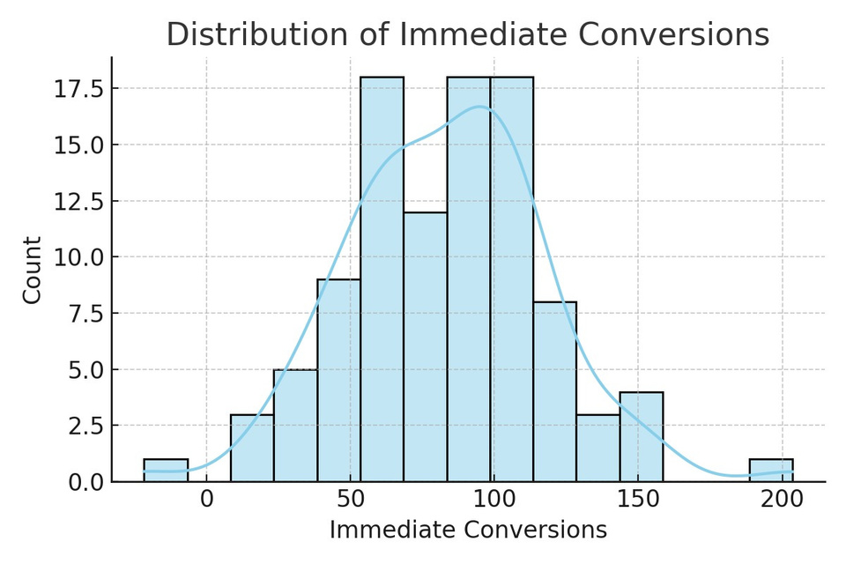
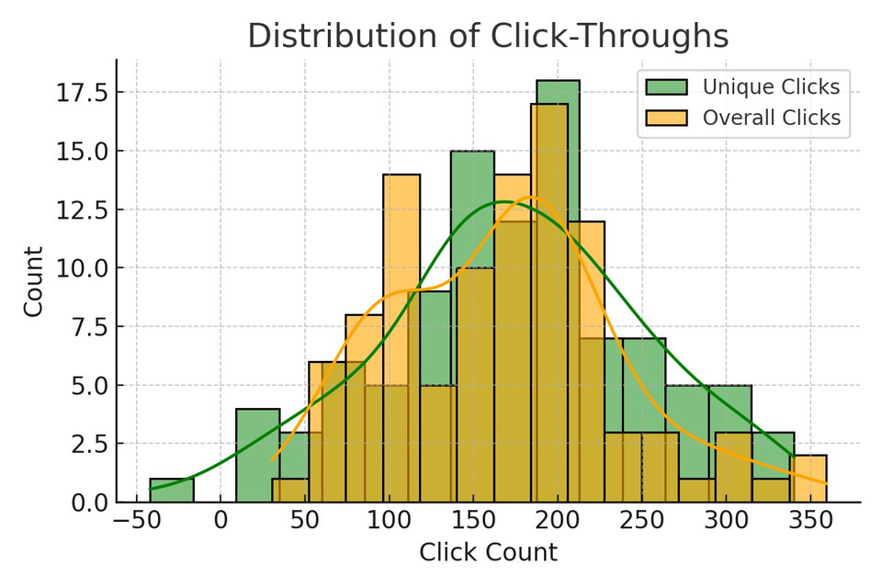

EDA: Engagement Metrics
Unique clicks higher than overall clicks median.
Conversions fairly consistent.
Impressions vary greatly.
Exploring creativity

Slide 6
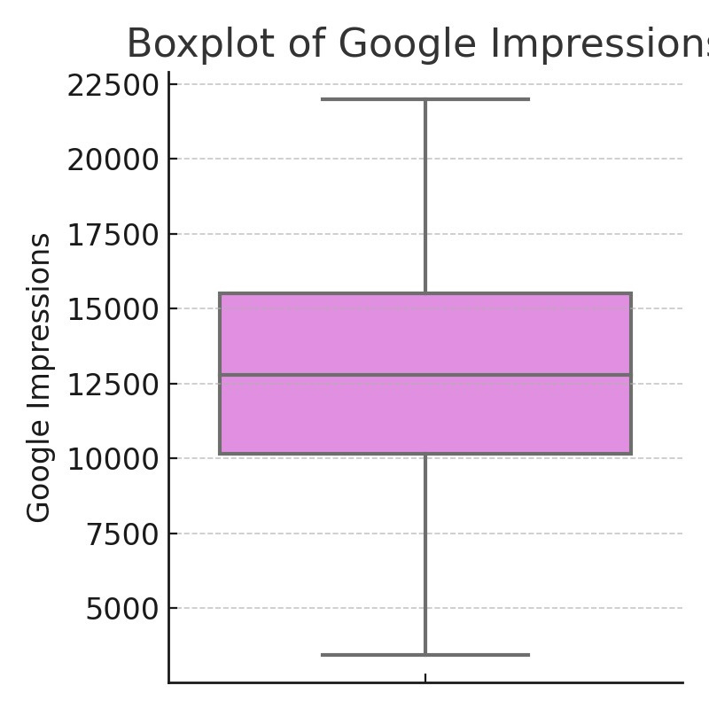

EDA: Google Impressions
High variance in impressions.
Suggests uneven reach across campaigns.

Slide 7
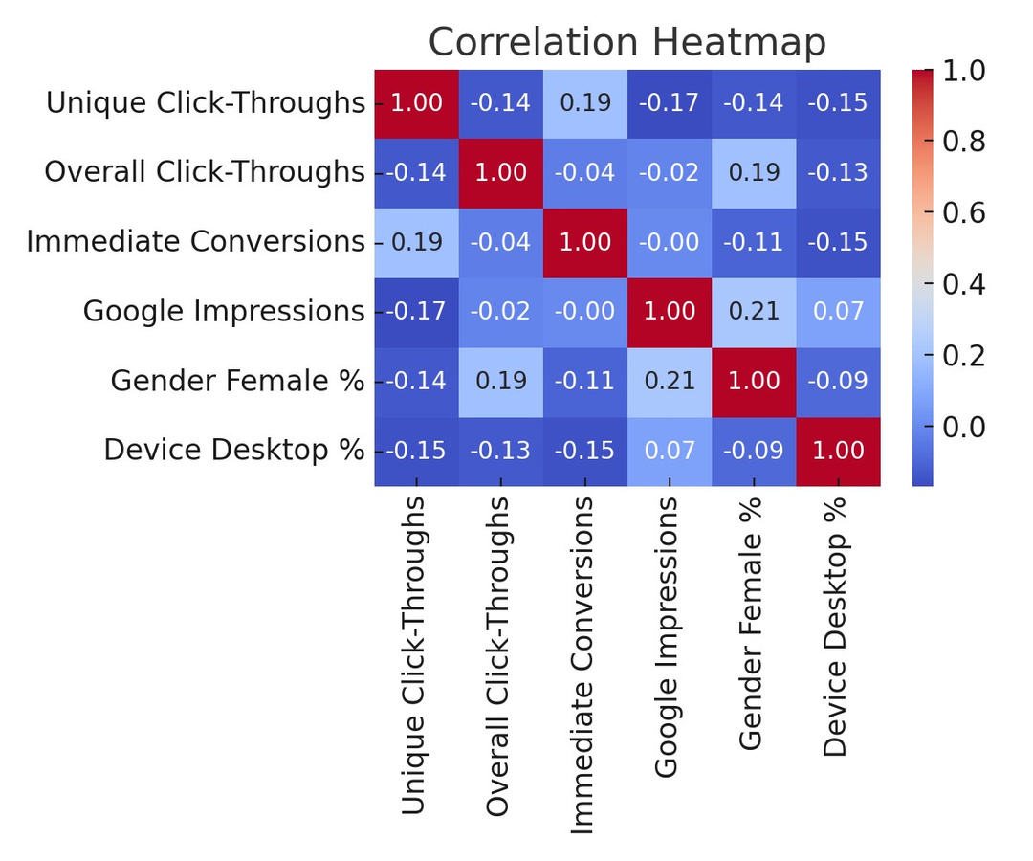
EDA: Correlations
Correlation Heatmap.
Unique clicks & desktop use most related to conversions.
Gender % and impressions show little direct effect.

Slide 8

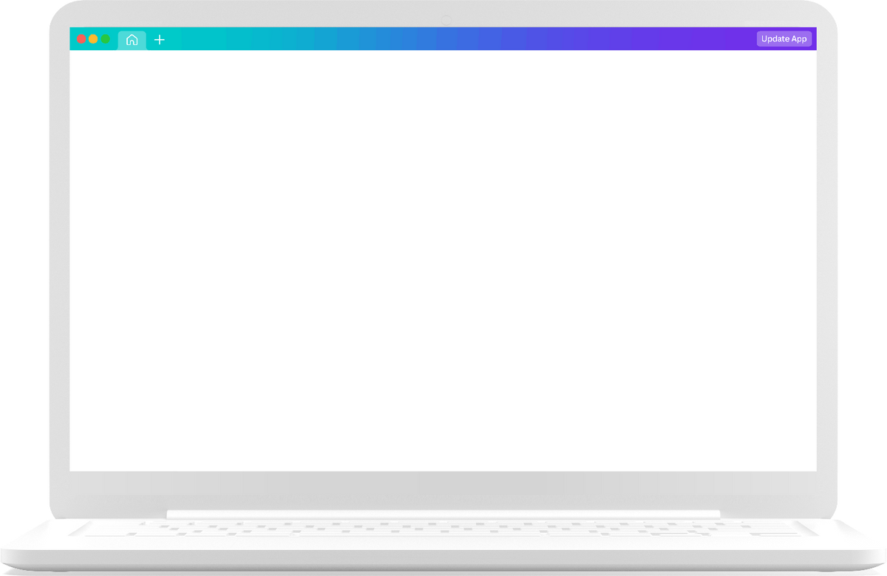
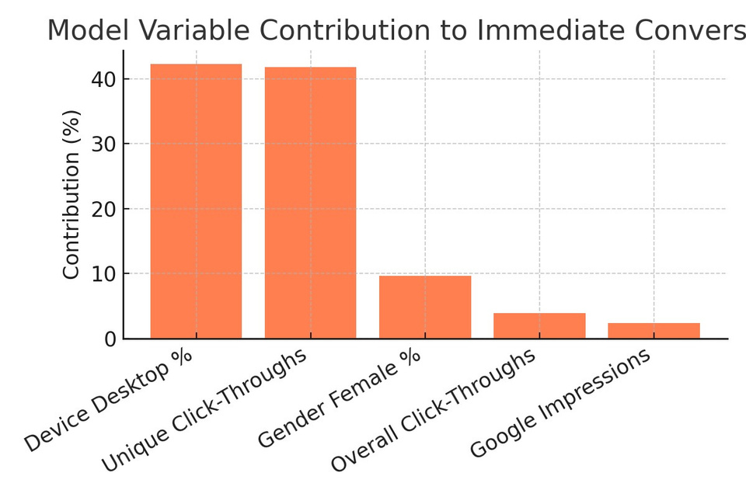

Predictive Model Insights
Variable importance rankings:
Device Desktop % – 42%
Unique Clicks – 41%
Gender Female % – ~10%
R² score: 0.154 (moderate explanatory power)

Slide 9
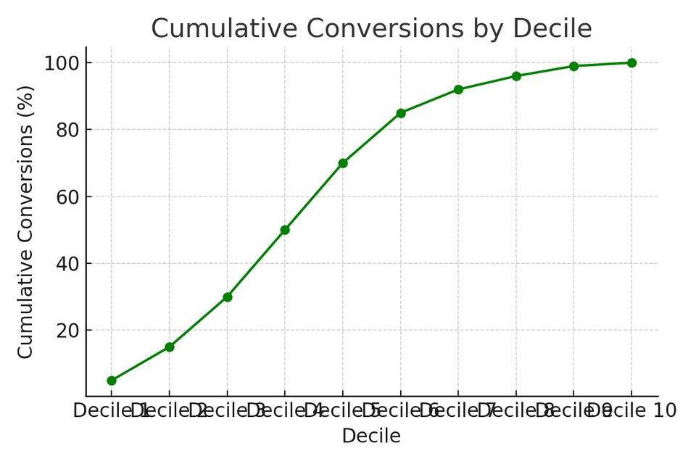

MODEL PERFORMANCE & GAINS
Top deciles capture a much higher share of conversions.
Example: Top 20% of audience delivers over half of total conversions.
Confirms model can guide targeted marketing for better ROI.
Top audience segments yield higher conversions.

Slide 10

Recommendations
Based on EDA & Model:
Focus campaigns on desktop users with high engagement history.
Improve targeting to increase unique clicks.
Reduce reliance on impressions-only campaigns.
Refresh content to convert visitors into leads.
Use chatbot to engage mobile-heavy audience.

Slide 11
Implementation Roadmap
SEO & keyword research
Content update
Chatbot & video integration
Analytics setup
Continuous optimization

Slide 12

Conclusion
Clear Insights: Data analysis revealed audience behavior patterns and engagement trends.
Key Drivers Identified: Unique clicks, desktop usage, and targeted content are top factors for conversions.
Aligned Strategy: Recommendations directly connect technical upgrades with proven audience needs.
Actionable Roadmap: SEO, content refresh, chatbot, and analytics will work together to boost engagement.

